Slide 1
Scott Cronin

Slide 2
Pipeline
10,000 articles scraped
Featurizing

Slide 3
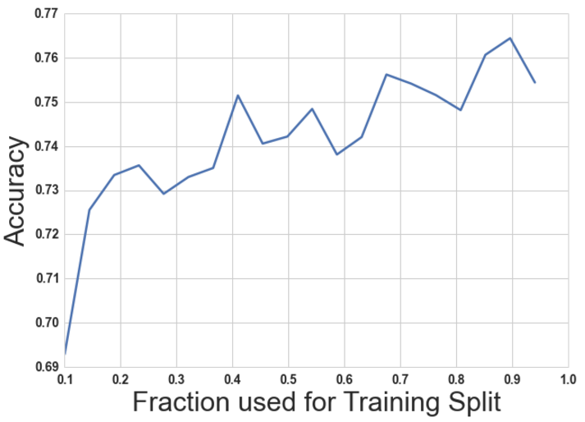
Accuracy vs Train Split Size
Training was done on 350 articles.
Increase training size from 30% to 70% (ie increasing from 100 articles to 250) improved model accuracy by 3%
Demonstrates some improvements in model, but there is limited return

Slide 4
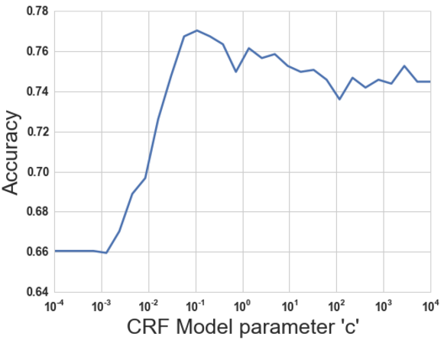
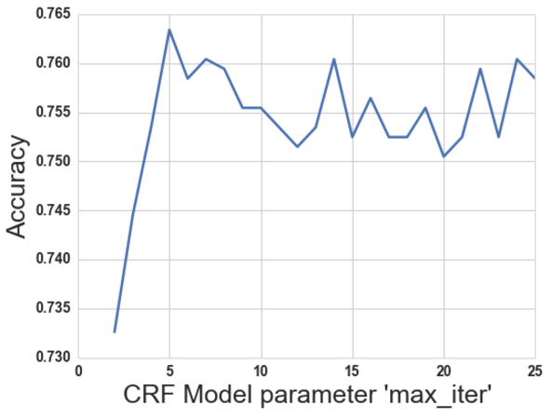
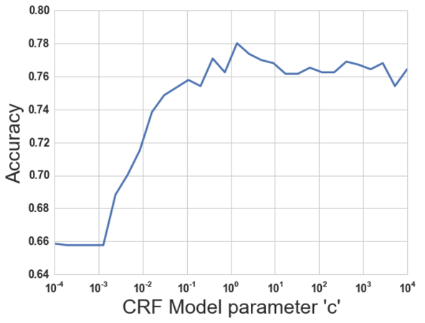
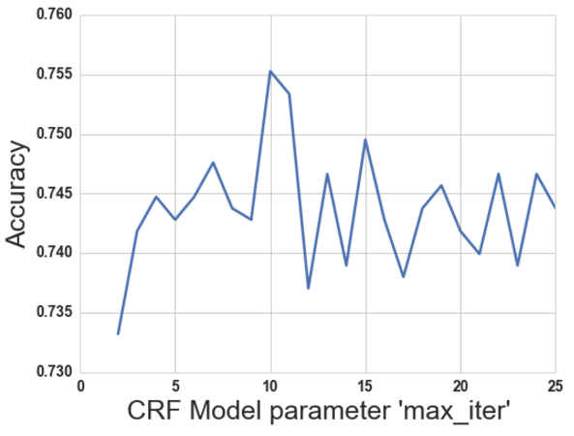
Model Tuning – Chain CRF
CRF Model parameter c = 0.5
CRF Model parameter max_iter = 11

